Slide 1
Integrals
Eric Prebys

Slide 2
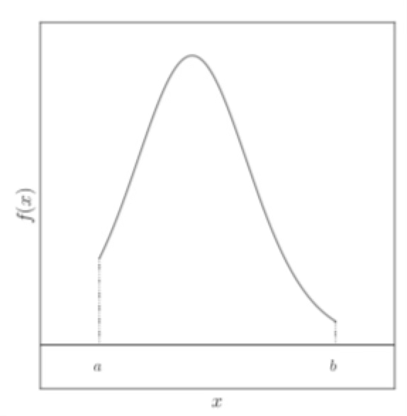
General Problem
Reduce an integral to a discrete sums
Start with n discrete points
Approximate as a sum

Slide 3
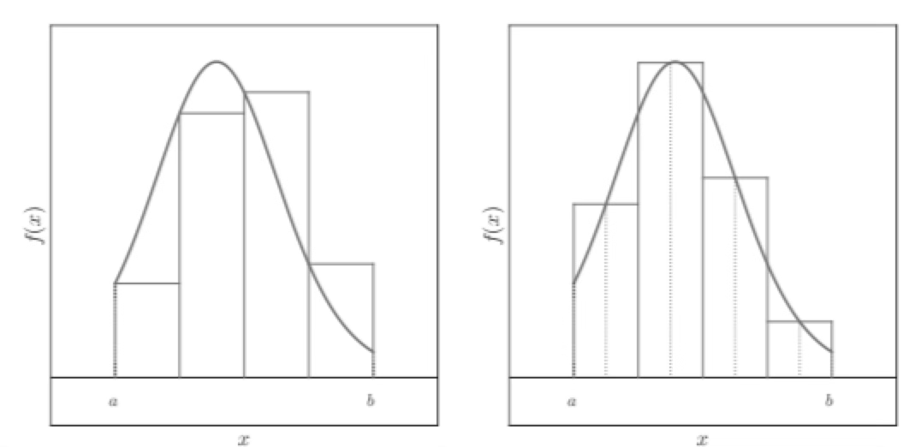
Left-side Rule Integrals
The simplest
Skip last point

Slide 4
Midpoint Rule
We can obviously do better if we use the midpoint

Slide 5
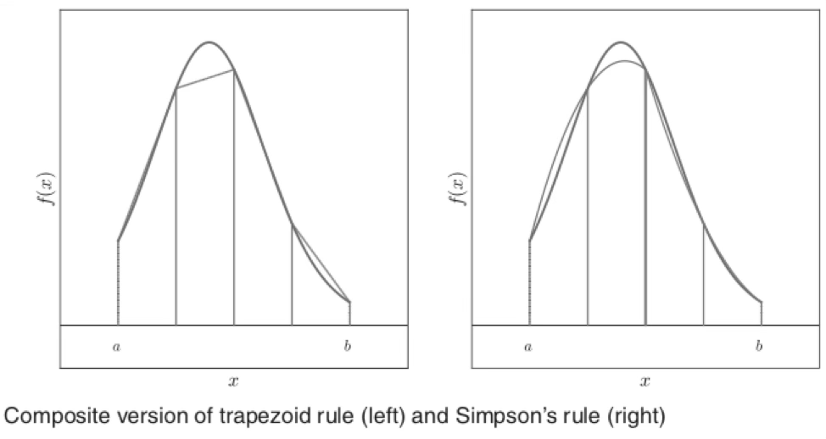
Trapezoidal Rule
This is based on approximating an integral by a trapezoid
Note: the integral if the trapezoid is just the integral of the mean.

Slide 6
Simpson’s Rule
Simpson’s Rule involves fitting a quadratic between three points
Assume three points lie on a parabola about

Slide 7
Simpson’s Rule (con’d)
The equations. Fron the second
Adding the first and third
Going back to the original equation

Slide 8
Error on Left-side Rule
If we Taylor expand about the starting point
The accumulated error then becomes

Slide 9
Error on Midpoint Rule
Set the midpoint at x=0 and expand
integrate from ci–h/2 to +h/2 (odd terms vanish)
Some point on the curve

Slide 10
Trapezoidal and Simpson’s rule (derived in book)
Trapezoidal Rule
Simpson’s Rule
(go to notebook…)

Slide 11
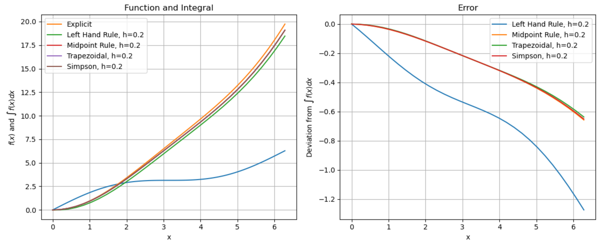
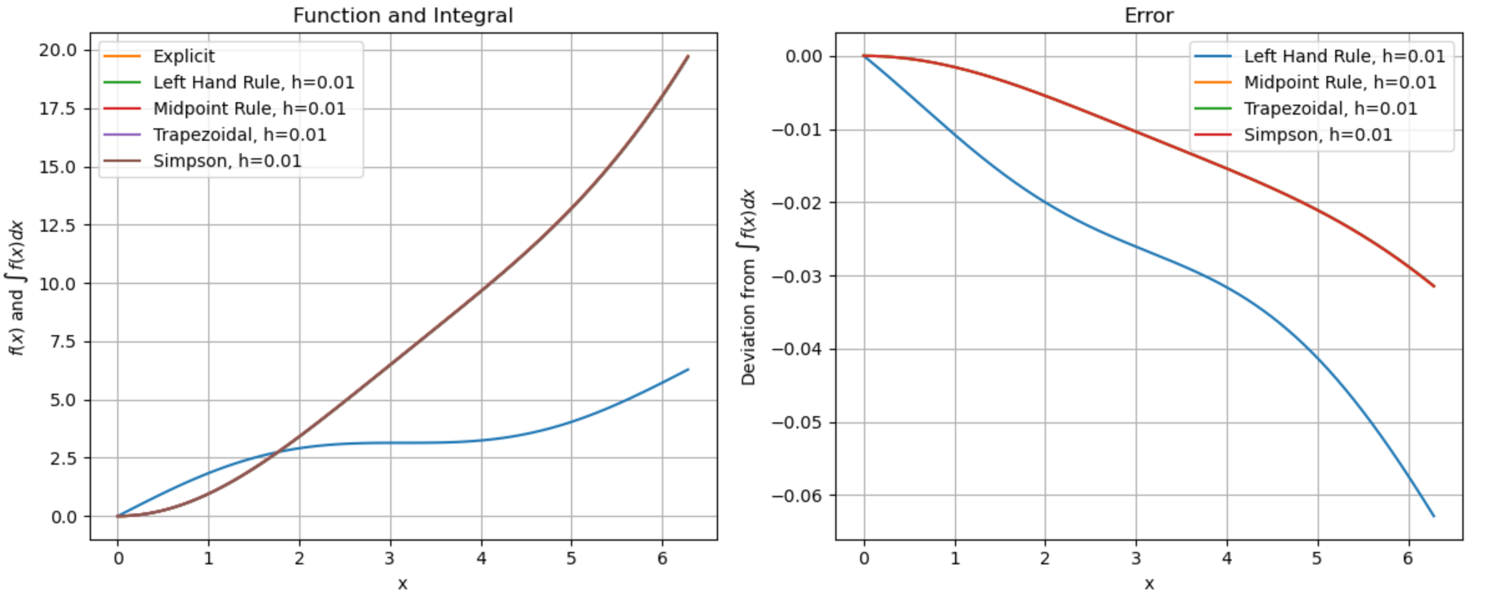
Simulation Results
h=.2
h=.01

Slide 12
Iterative Trapezoid (Next Week’s Lab)
In most cases, rather than calculate the error, it’s easier to simply reduce the step size until the integral stops changing.
In the case of the Trapezoid Rule, you can begin dividing the interval by two each iteration.
For each value h_{m}, calculate the integral I_{m}. Continue until
Note that for each iteration, half the points were points you used before, so you could save a teeny bit of time by basing each integral on the previous integral
but to be honest, it would probably take you more time to get the algorithm
right than you would save!
Predetermined accuracy target

Slide 13
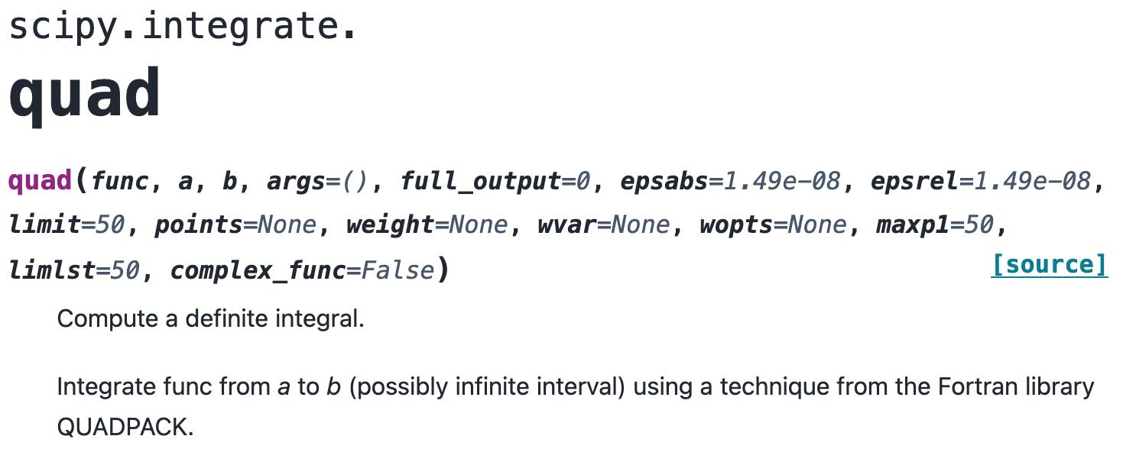
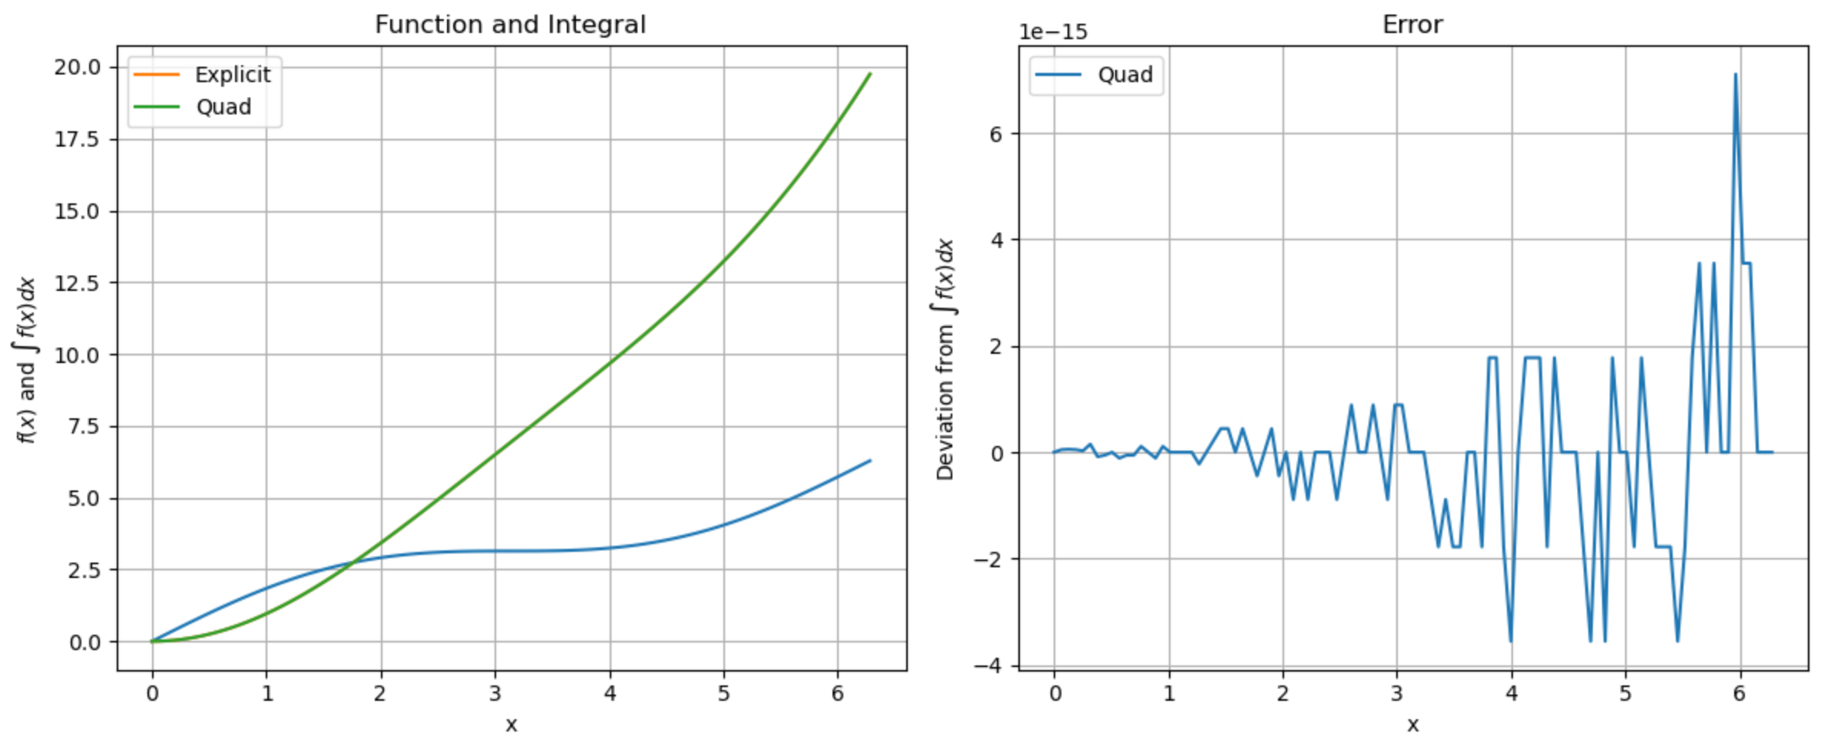
Built-in Integration tools

